Slide 1
Istanbul House Price Prediction and Visualization System
Kaan Akkök Melih Gülbay

Slide 2
Introductıon:
The complexity of the Istanbul real estate market and Turkey’s economic challenges make it difficult to make price predictions and market analysis.
This project aims to overcome these challenges with machine learning and data visualization tools.
It aims to help both real estate professionals and buyers understand market trends and make the right decisions.

Slide 3
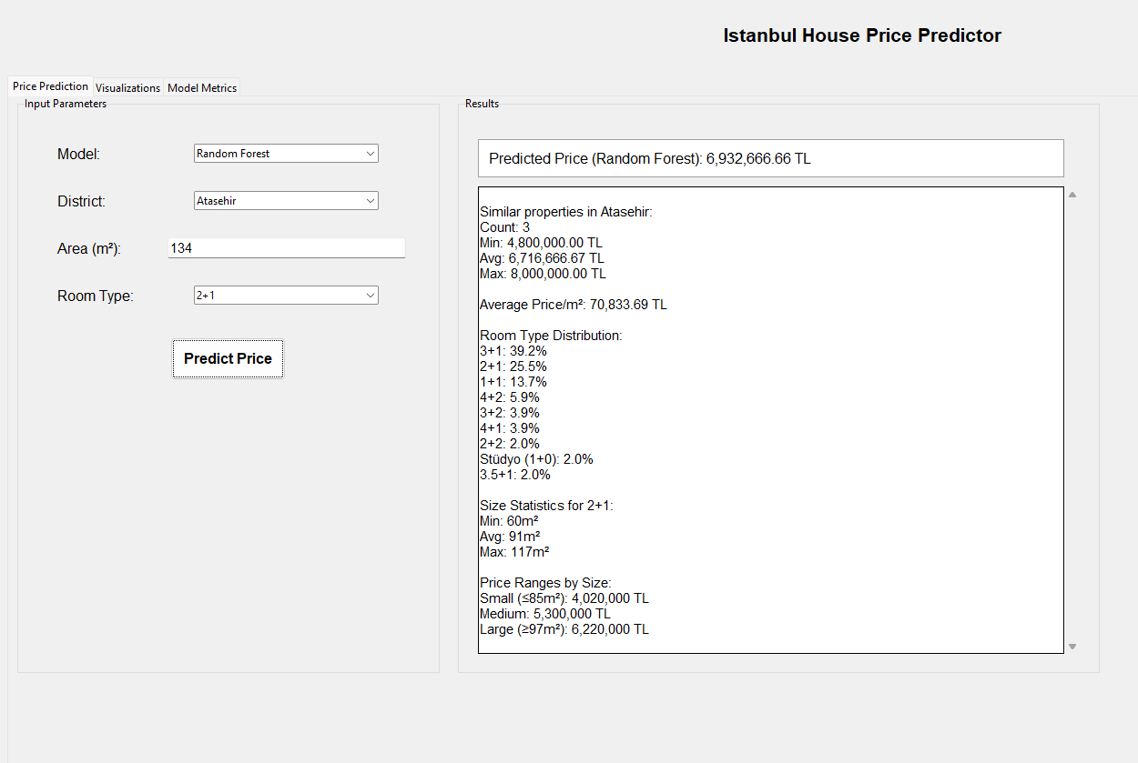
PROJECT GOALS:
Predict house prices with high accuracy.
Enable users to analyze and compare data visually.

Slide 4
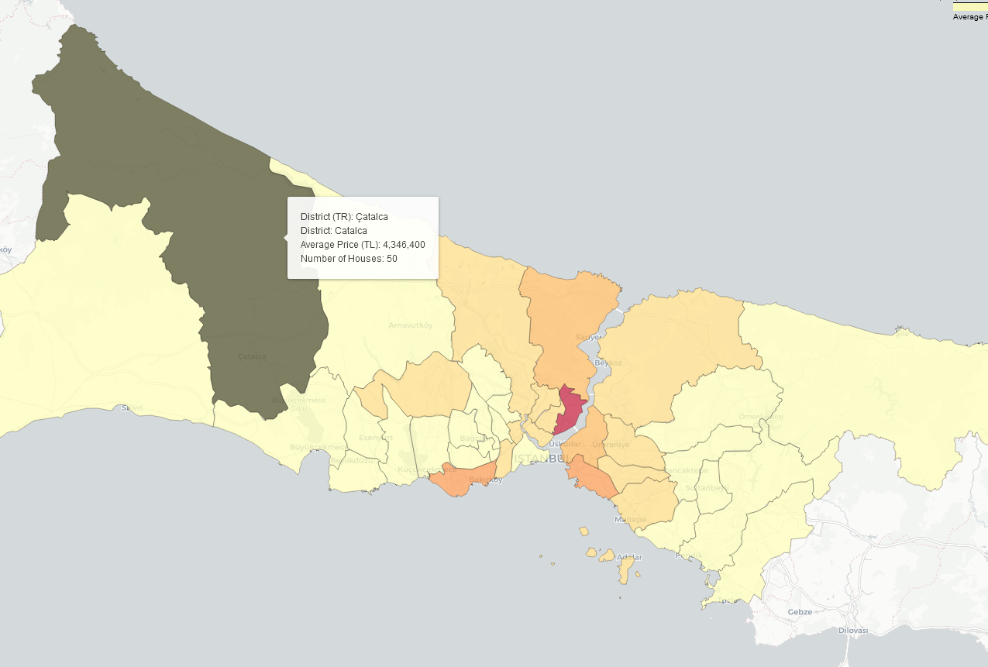
System desıgn:
Data Collection: - we use undetected_chromedriver, selenium and csv libraries for web scraping and data saving.
Machine Learning Models: - we use linear regression, random forest regression, support vector regression, gradient boosting and xgboost models.
Data Visualization: - we use geopandas, folium and matplotlib libraries for data visualization.
User Interface: - we use tkinter library for gui.

Slide 5
Models
1. Linear Regression: Assumes a linear relationship between features and target; simple and interpretable.
2. Random Forest: Uses multiple decision trees to improve accuracy and reduce overfitting; handles non-linear relationships well.
3. SVR (Support Vector Regression): Fits data within a margin; effective in high-dimensional spaces; requires feature scaling.
4. Gradient Boosting: Sequentially builds trees to correct errors; captures complex patterns but can overfit.
5. XGBoost: An efficient, regularized version of gradient boosting; excels in performance and scalability.

Slide 6
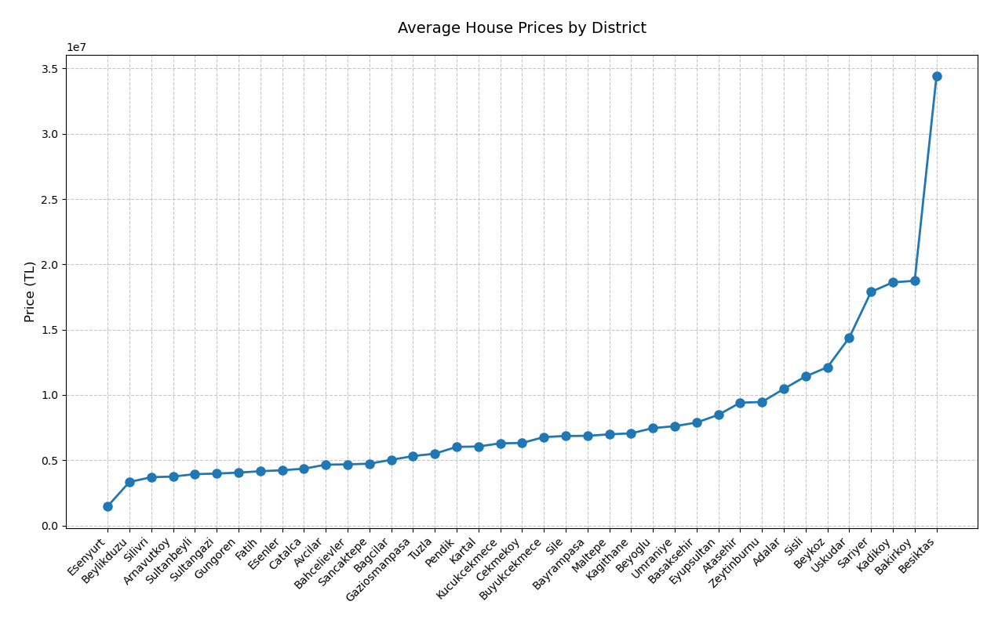
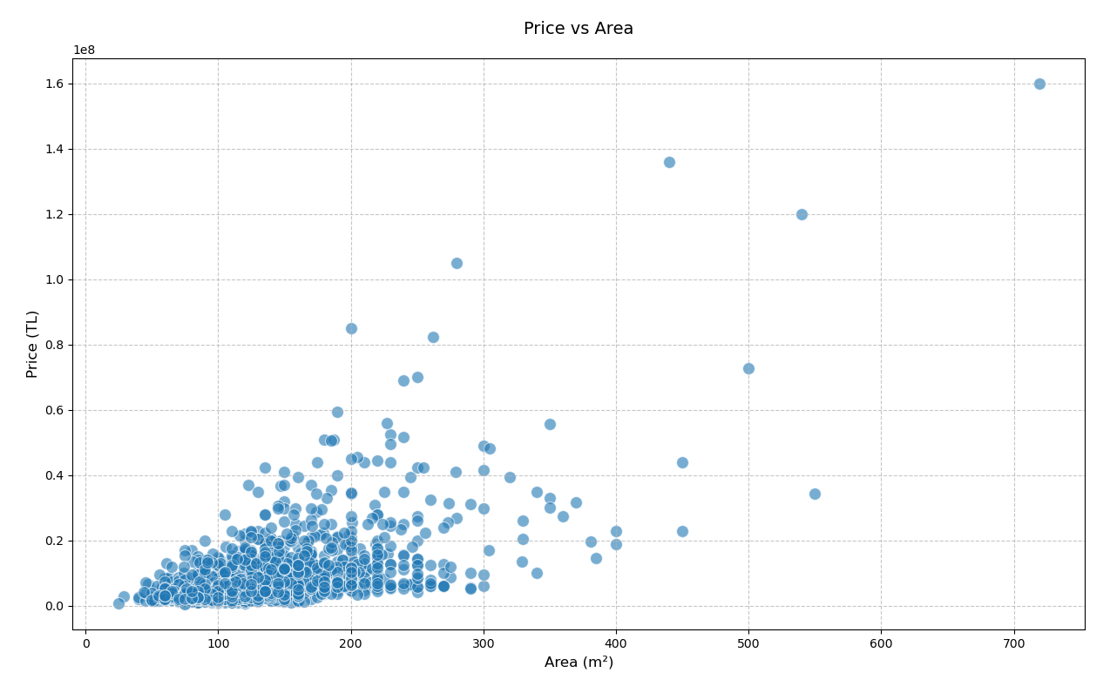

Slide 7
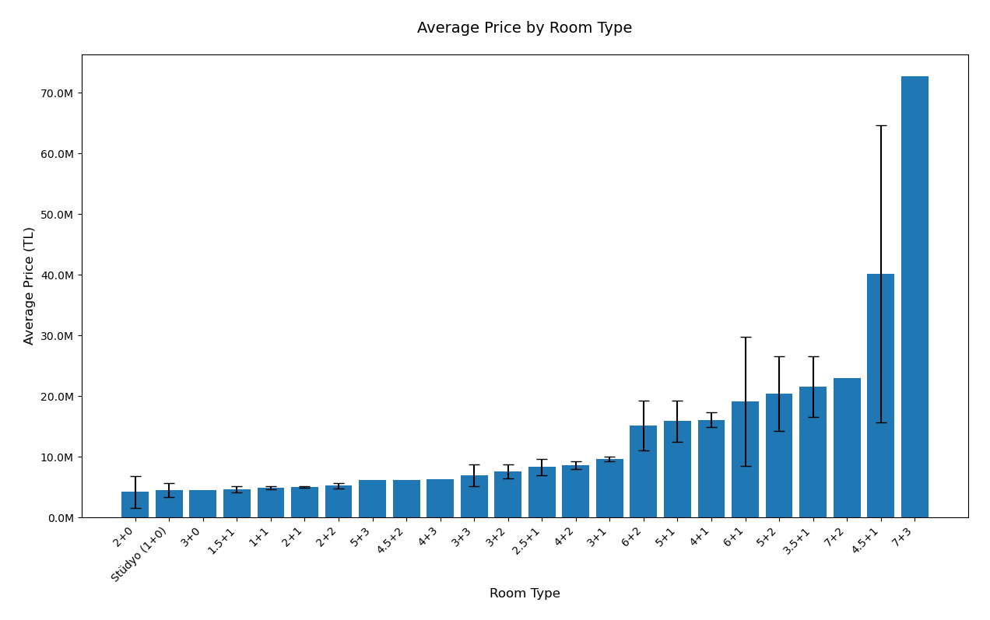
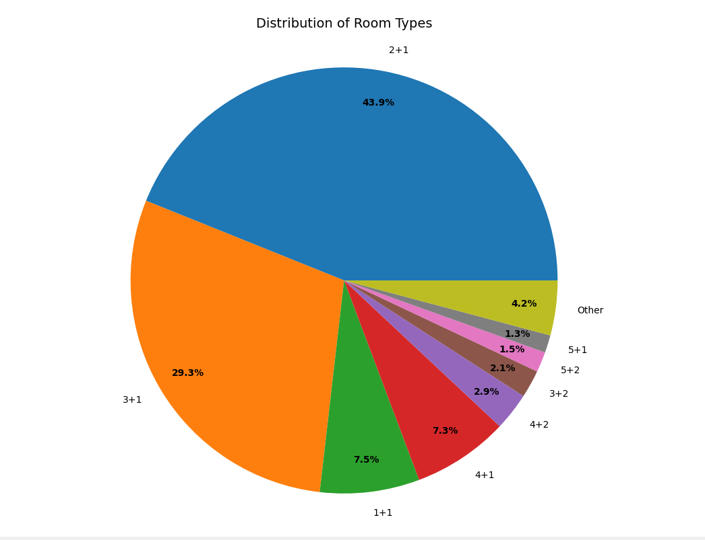

Slide 8
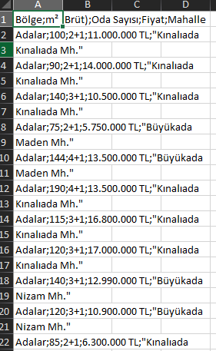
DATASET AND DATA PROCESSıNG:
We retrieve the region, gross, number of rooms, price and neighborhood data of houses in the districts of Istanbul from sahibinden.com with the script.py file and store this data as a csv file (1969 data).
Then we extract "TL" from the price values ​​in the dataset and convert it to a float value, and clean the empty or missing rows from the dataset.
Then we determine the parameters for our models. These are:
X (independent variables): - gross(m^2) - number of rooms - region (converted to binary value with one-hot encoding)
Y (dependent variable): - price(TL)

Slide 9
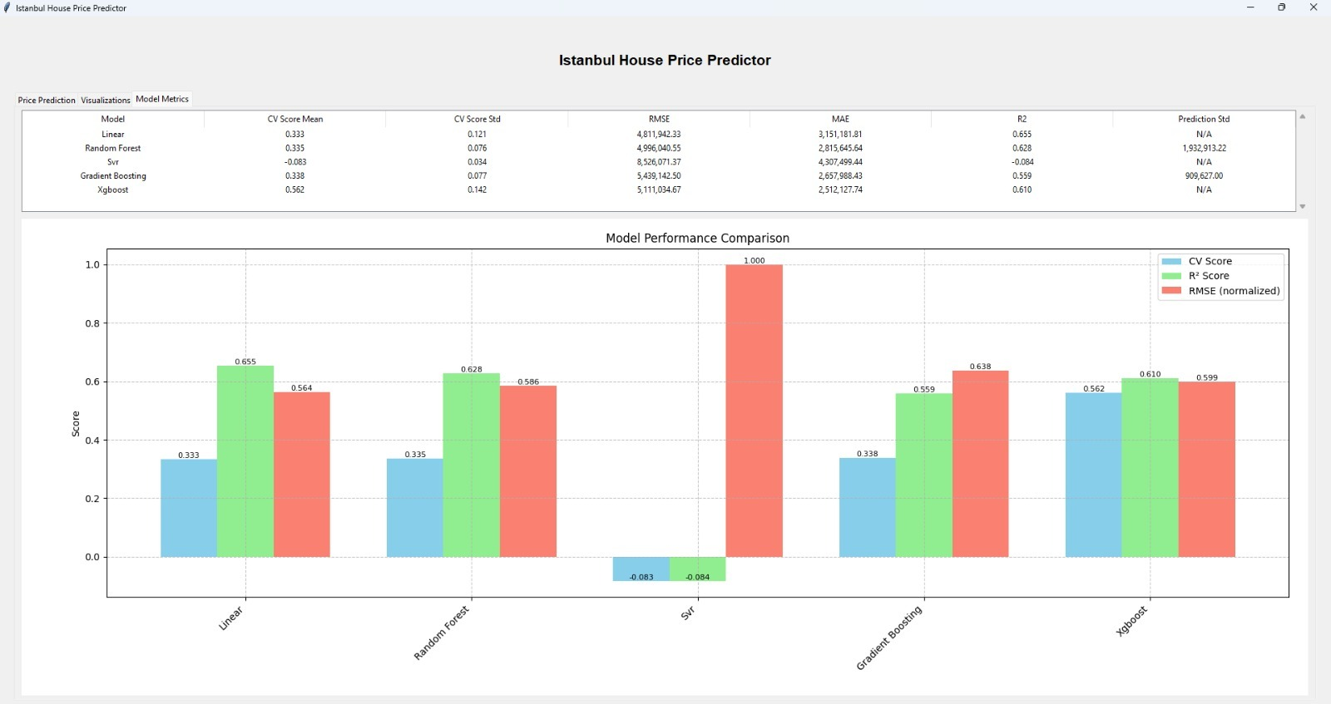
MODEL TRAINING AND EVALUATION:
We train our models with the data we have prepared. Then we evaluate the results of these models.
For evaluation: - Cross-validation - RMSE (Root Mean Square Error) - MAE (Mean Absolute Error) - R^2 Score - models testing
By comparing the obtained metrics, we show the best performing model.

Slide 10
Model Results
Linear Regression
CV Score Mean: 0.333 → Fair generalization
CV Score Std: 0.121 → Moderate consistency
RMSE: 4,811,942 TL → High error magnitüde
MAE: 3,151,181 TL → High average error
R²: 0.655 → Explains 65.5% of price variation
Random Forest
CV Score Mean: 0.335 → Fair generalization
CV Score Std: 0.076 → Good consistency
RMSE: 4,996,040 TL → High error magnitüde
MAE: 2,815,645 TL → Moderate average error
R²: 0.628 → Explains 62.8% of price variation
Prediction Std: 1,932,913 TL → High prediction uncertainty
SVR (Support Vector Regression)
CV Score Mean: -0.083 → Poor generalization
CV Score Std: 0.034 → Very consistent (but consistently poor)
RMSE: 8,526,071 TL → Very high error magnitüde
MAE: 4,307,499 TL → Very high average error
R²: -0.084 → Model performs worse than a horizontal line
Gradient Boosting
CV Score Mean: 0.338 → Fair generalization
CV Score Std: 0.077 → Good consistency
RMSE: 4,439,142 TL → Moderate error magnitüde
MAE: 2,657,988 TL → Moderate average error
R²: 0.559 → Explains 55.9% of price variation
Prediction Std: 909,627 TL → Moderate prediction uncertainty
XGBoost
CV Score Mean: 0.562 → Good generalization
CV Score Std: 0.142 → Moderate consistency
RMSE: 5,111,034 TL → High error magnitüde
MAE: 2,512,127 TL → Moderate average error
R²: 0.610 → Explains 61% of price variation

Slide 11
CoNCLUSION:
In conclusion, This Project combines machine learning capabilities with interactive visualization tools to provide a comprehensive solution for house price prediction and market analysis in Istanbul.
THANK YOU FOR LISTENING

